Slide 1
DISCNGINE INTRODUCTION
MaBi 2022
S. Conilleau

Slide 2
Agenda
Discngine
17 raisons pour lesquelles vous devriez rejoindre un master Bioinfo (la 14 est vraiment géniale)

Slide 3
DISCNGINE
01
A SOFTWARE COMPANY FOR LIFESCIENCE RESEARCH

Slide 4
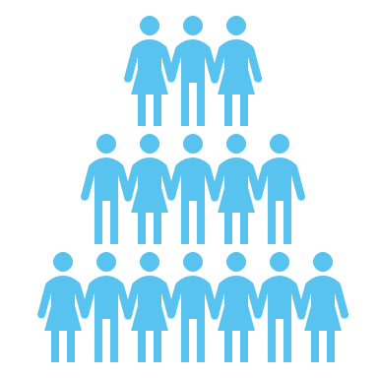
Company
SOFTWARE FOR LIFE SCIENCES RESEARCH
2004
Paris
Remote 1st
~60 employees
>70 customers worldwide
More Information: www.discngine.com

Slide 5
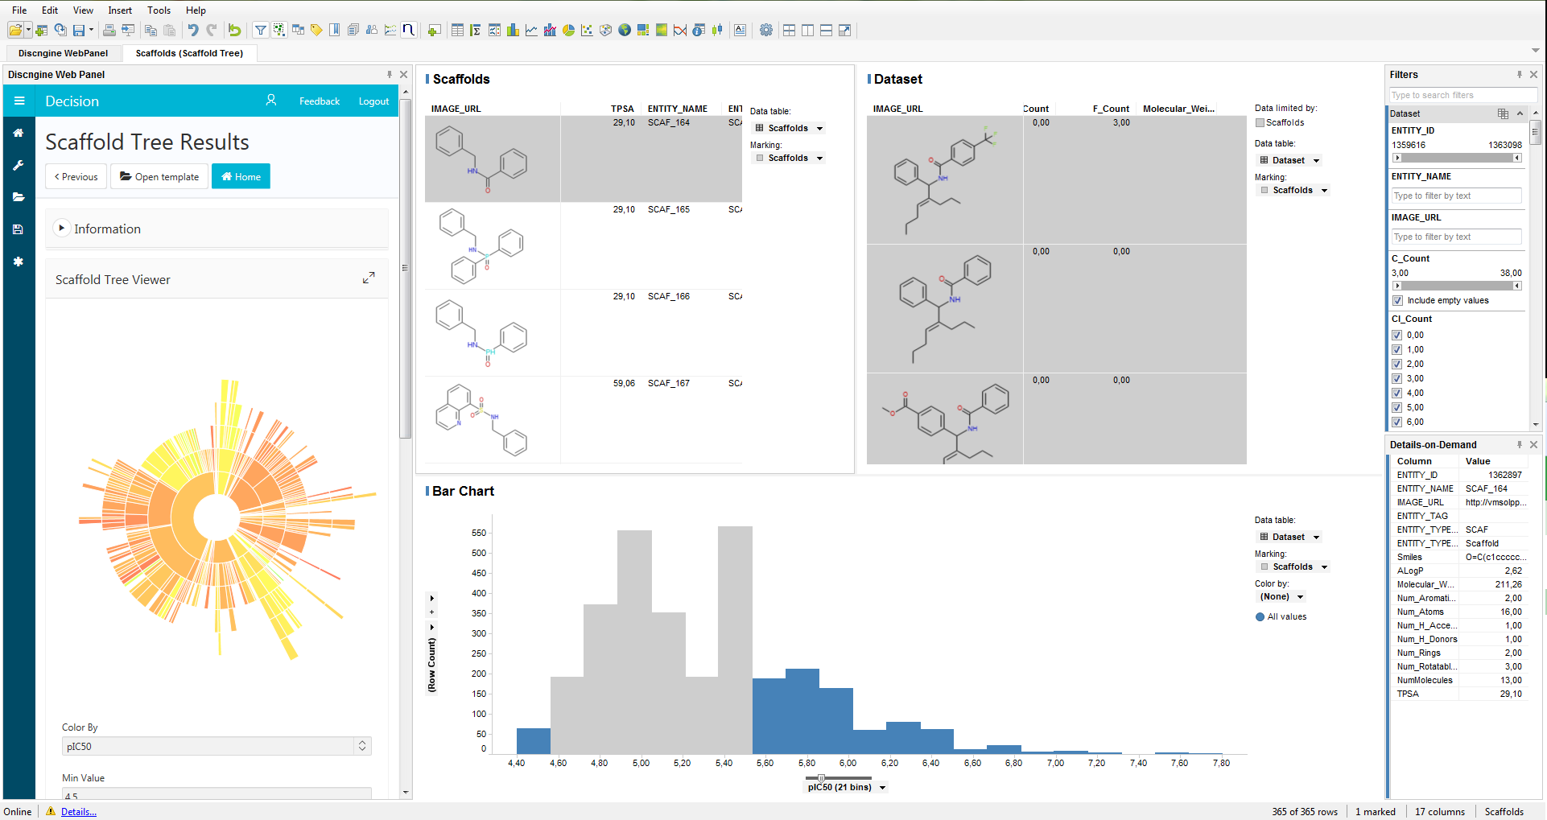
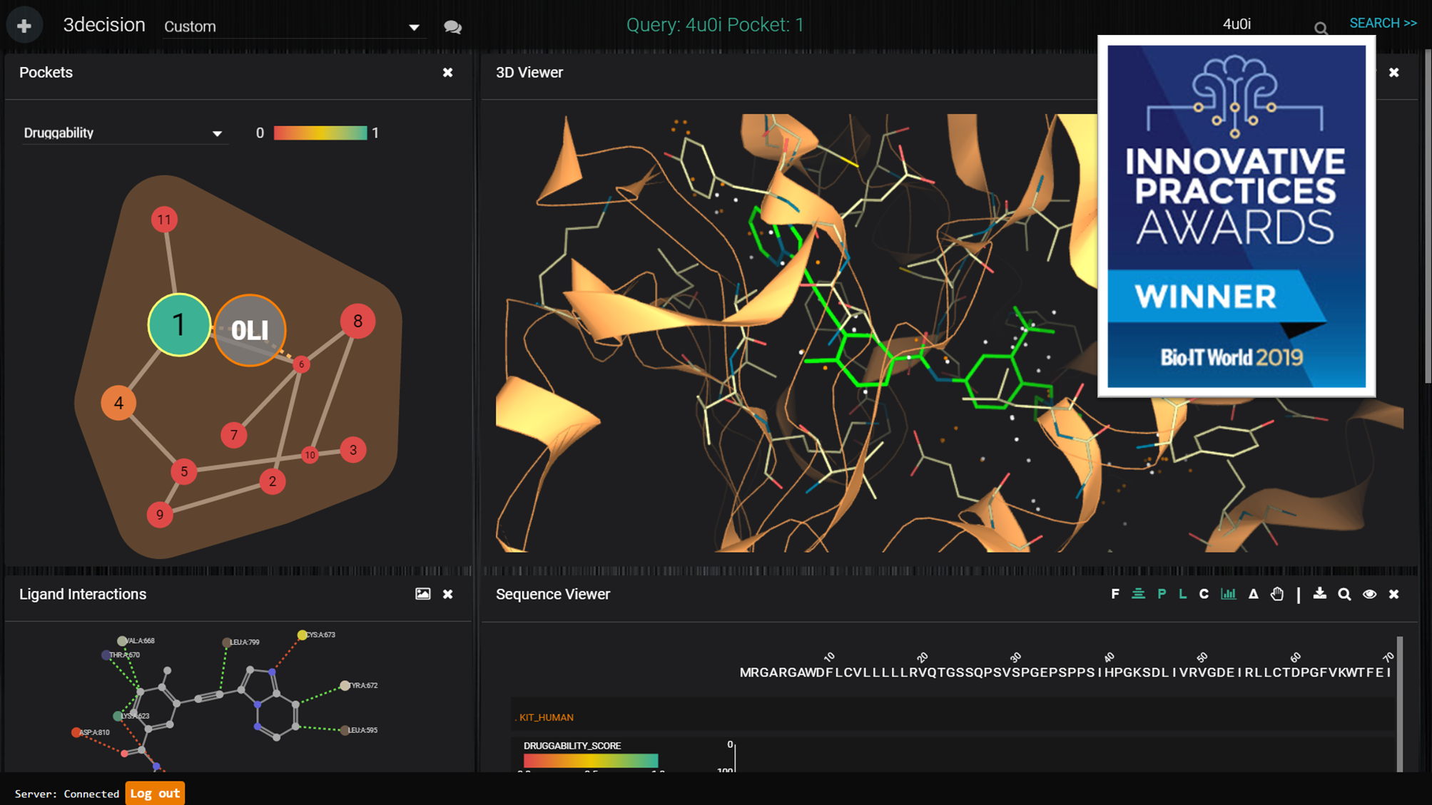
Our Focus
New Molecule Discovery
Scientific Data Science
Data acquisition and analysis – Sample management
Cheminformatics & Bioinformatics

Slide 6
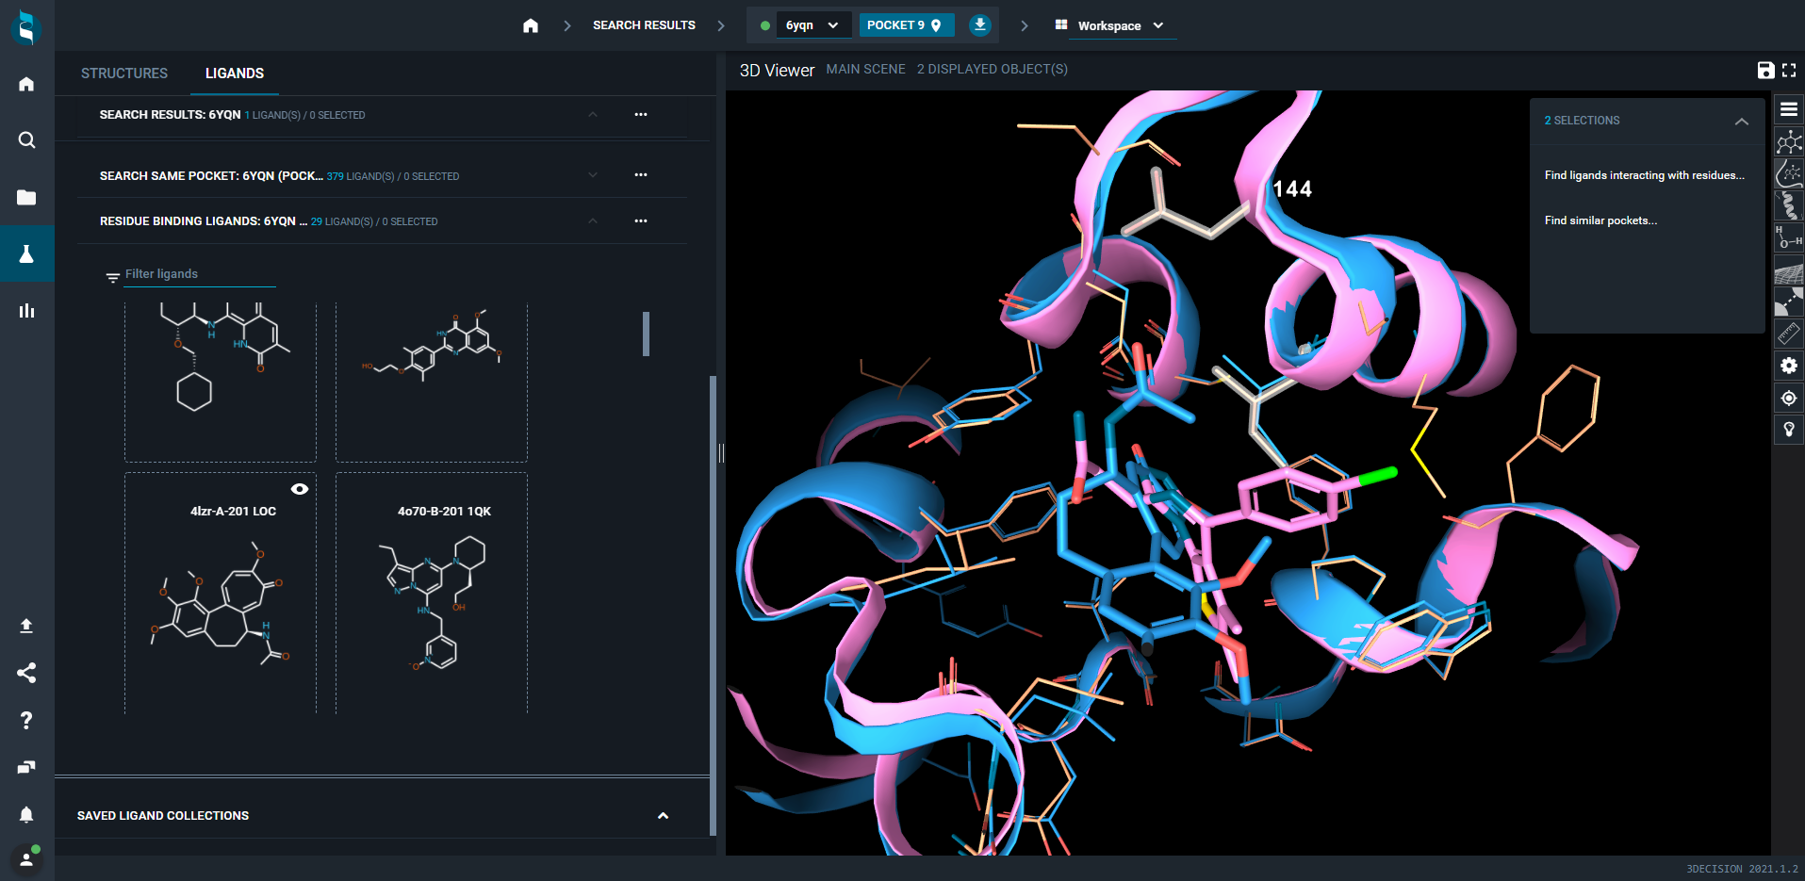
Cheminformatics & Bioinformatics

Slide 7
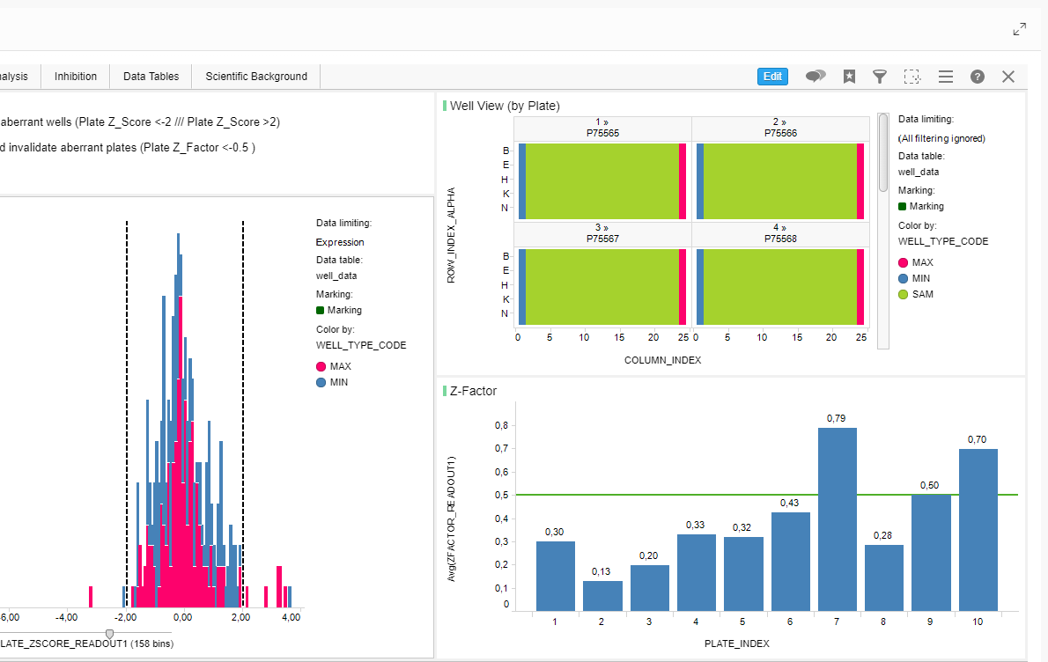
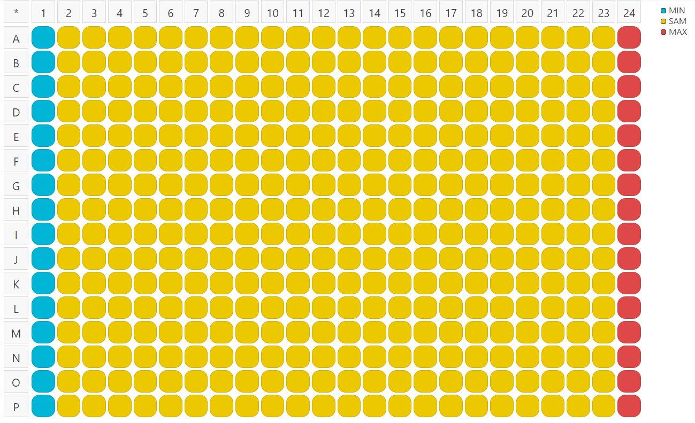
Data acquisition and analysis – Sample management

Slide 8
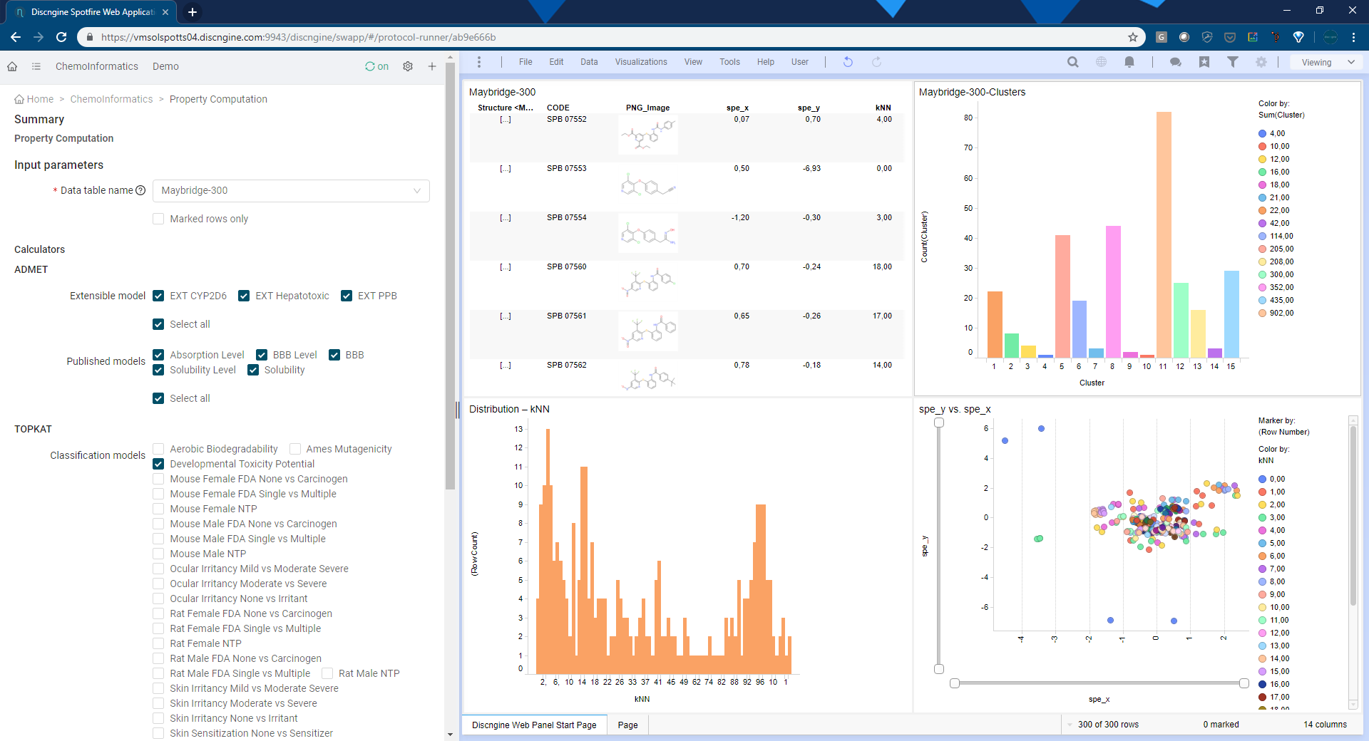
Scientific Data Science

Slide 9
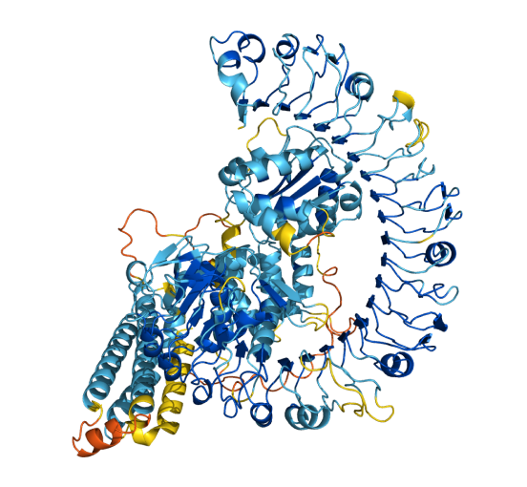
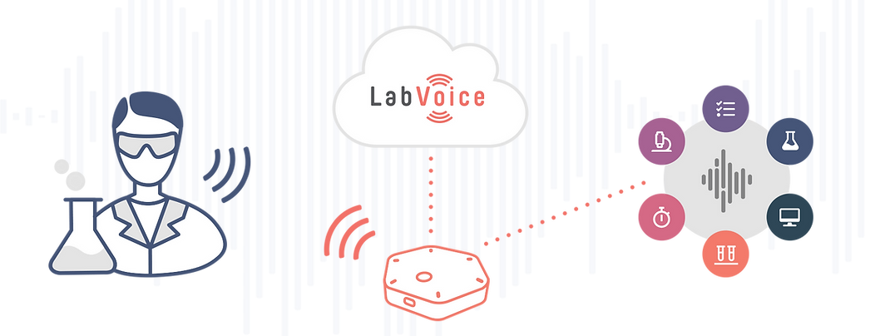
What’s next

Slide 10
Clients

Slide 11
People
Profiles
Multi-skills profiles
Chemist/Biologist + Computer science
Education ranging from Master’s degree to Postdoctoral studies
Internally trained to key technology
Partner software
Modern Development Frameworks
French natives, fluent English speakers

Slide 12
Cloud 1st

Slide 13
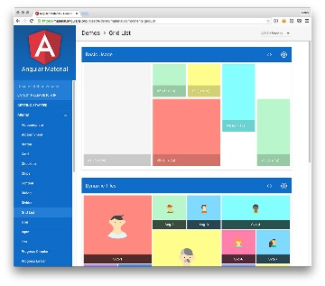
Diverse & up-to-date stack

Slide 14
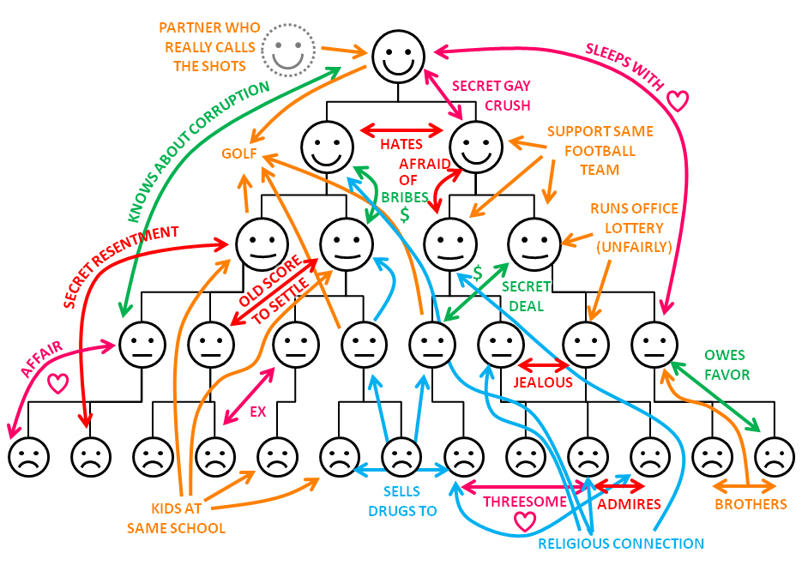
Non-hierarchical model

Slide 15
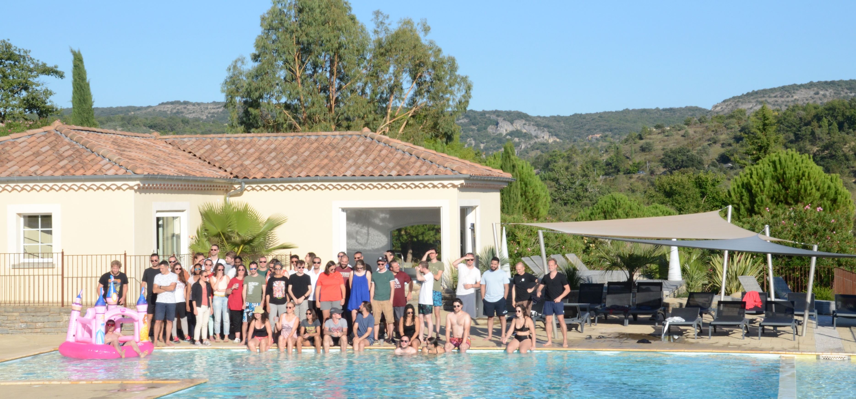
With benefits
Photo drôme

Slide 16
17 REASONS WHY YOU SHOULD JOIN A BIO-INFORMATICS MASTER
02
Number 14 is incredible

Slide 17
17 REASONS WHY …
Competitive skillset
Lots of start up, few ESN
Room for improvement
Fundraising & investments
https://www.welcometothejungle.com/en/companies/discngine
https://www.sfbi.fr/
sebastien.conilleau@discngine.com
Notes:
Y’a du taf

Slide 18
Thanks

